Slide 1
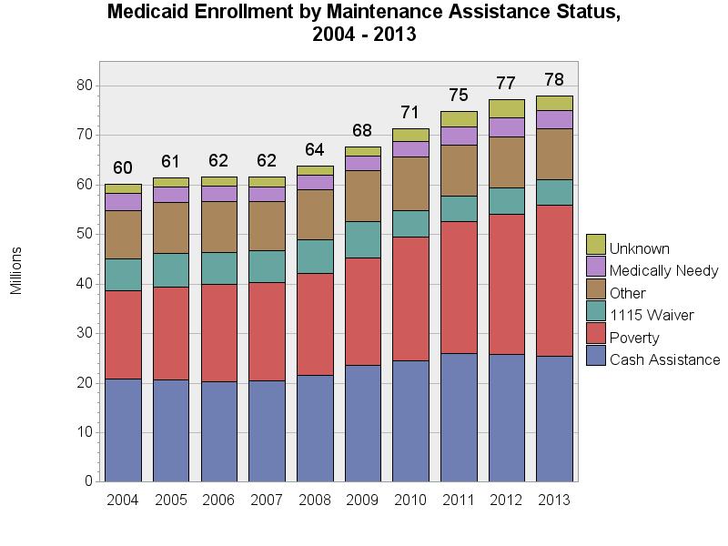
SOURCE: Chronic Condition Data Warehouse (CCW). MAX Person Summary Files.
Notes:
Description: The number of people enrolled in Medicaid has increased since 2004, with large growth in 2008 through 2010. The largest categories for any given year are poverty and cash assistance – together constituting approximately 65-70% of enrollees; this proportion has remained stable over time. The proportion of enrollees eligible due to being medically needy decreased slightly from 5.5% in 2004 to 4.3% in 2013; the proportion enrolled due to poverty has increased from 29.7% in 2004 to 39.1% in 2013.
Technical notes: Maintenance Assistance Status – determined using the first digit of the uniform eligibility code.

