Slide 1
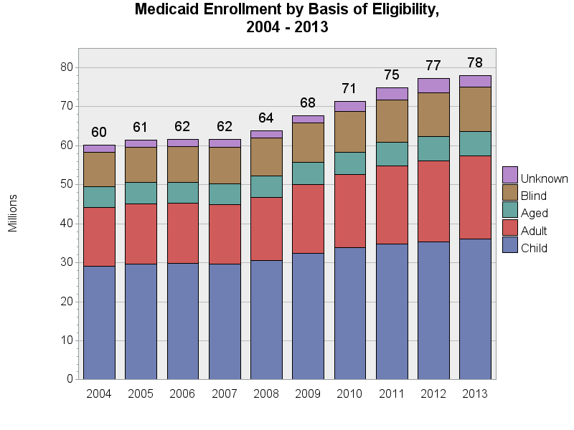
SOURCE: Chronic Condition Data Warehouse (CCW). MAX Person Summary Files.
Notes:
Description: The number of people enrolled in Medicaid has increased since 2004, with large growth in 2008 through 2010. Around 45.7-48.3% of enrollees for any given year were classified as “Child”. The proportion of enrollees within each category of basis of eligibility has been quite stable over time.
Technical notes: Basis of Eligibility – determined using the second digit of the uniform eligibility code. The “Blind” category includes blind/disabled.

